Slide 1
Network scanning

Slide 2
What is NMAP
Nmap is short for Network Mapper
An open source utility (available for many OS: linux, mac..)
Can quickly scan a broad range of devices and provide valuable information of hosts
Uses raw ip packets to determine:
Vulnerability detector (white hats)
Reconnaissance/security holes by attacker
Detect live hosts on network
Detect open ports on hosts
Detect sw, os and version
NMap Can be detected by most IDS/IPS

Slide 3
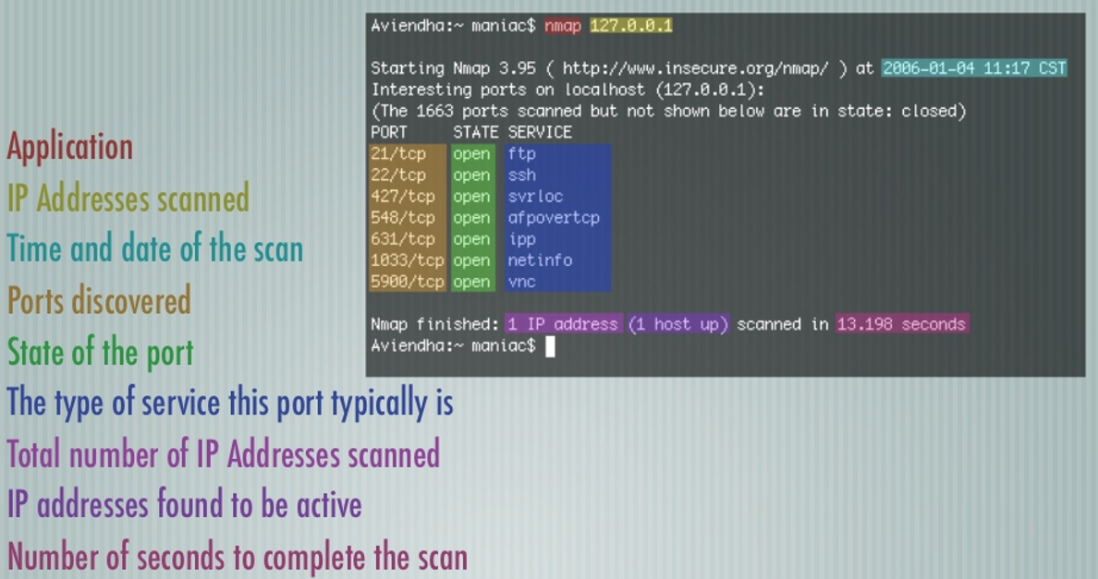
s
Basic nmap scan example

Slide 4

ports - six states
Filtered: nmap cannot reach the port and determine if it’s open or closed
Unfiltered: nmap can reach the port but cannot determine if it’s open or closed (only ACK use this state)
Open|filtered: this happend when open ports gives no response.
Closed|filtered: nmap is unable to determine if the port is closed|filtered

Slide 5
SYN, Fin, ack
SYN Scans
Pro: very fast, most common scan used.
Con: when a FW or a packet-filter is in between you and the target the result can be funky.
FIN Scan
Pro: can sneak around non-stateful FW and packet filters
Con: port responds as either closed or open|filtered
ACK Scan
Pro: determine filtered from unfiltered ports.
Con: won’t tell if the port open or closed.

Slide 6
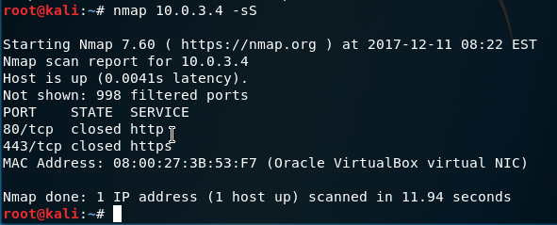
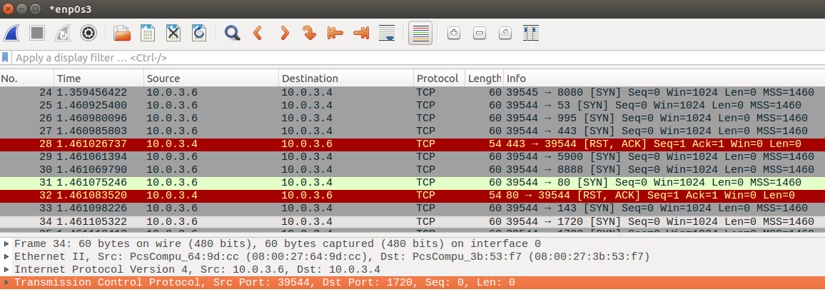

Slide 7
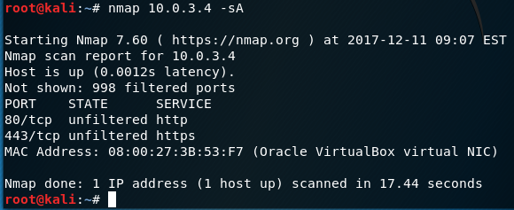
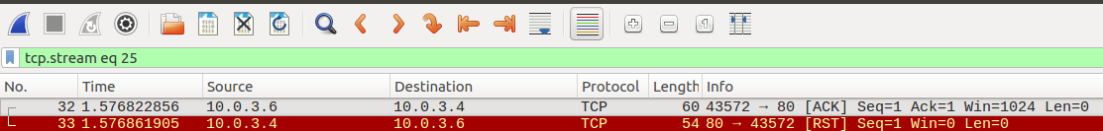

Slide 8
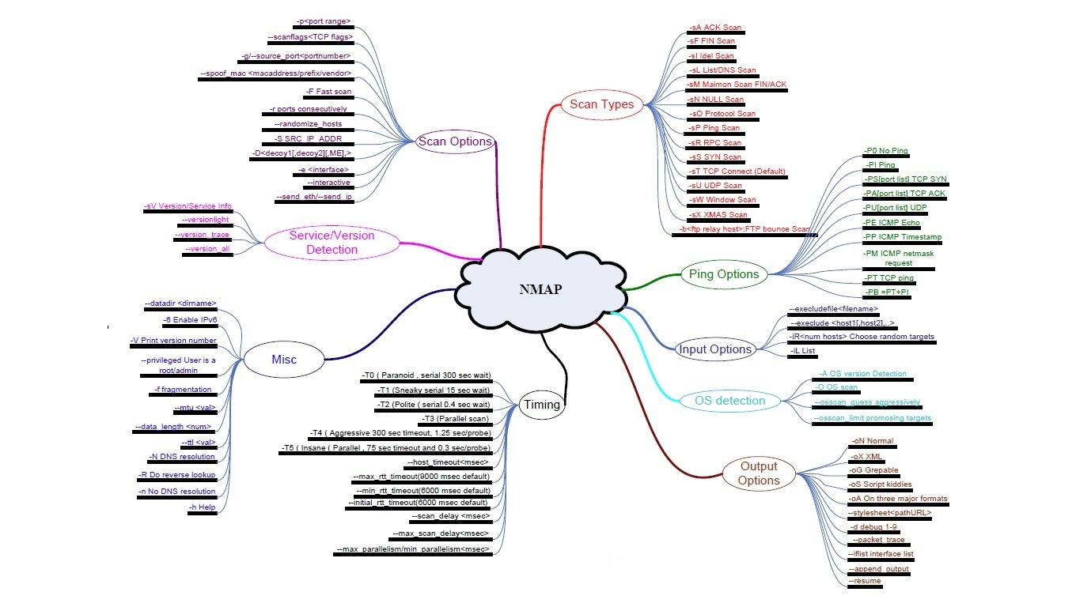

Slide 9
NMAP scanning options
nmap is used to perform network scan nmap
-0 www.xx.com www.yy.com (scan for OS on serveral host names)
-vv: increased verbosity level (more information)
-sn: no port scan – like pingscan but can also request traceroute
-sP: ping scan – are the host alive
-sS: a stealth syn scan – stopper ved transport laget (default scan if root privilege). A very quit scan. It’s a SYN scan. Sends SYN but no ACK.
-sT: scan a host for most commonly used ports with TCP SYN. (default if no root privilege)
-sU: scan a host for open UDP ports only.
-sV: service scan. It will try to figure out what version of services and also OS there’s running.
-sO: scan for which protocols (not ports) the host support and the status of them.
-O: see what OS is running -n: no DNS resolution since that can be slow.
-r: scan ports in order -F: makes the scan faster by skipping most of the default ports.
-Pn: treat all hosts as online. Don’t ping them first – just check the ports.
-PS: if firewalls block icmp ping requests a tcp ack and tcp syn method can be used.
-p21 -p-: scan a specific port or a range of ports. -p- is scan all the ports.
192.168.1.1/24: how many bits used for network and host addresses.
192.168.1.1/24 -T4: speed of scan 0-5 (parnoid, sneaky, polite, normal, aggresive, insane)
192.168.1.1-100: (scan all hosts from 1-100)
-oG: make output in grepable format grep ‘open’: grep bruges til at søge i tekstfiler. Awk {} kan også anvendes.
--iflist: list host interfaces and routes
sudo nmap -sU -sT U:53 T:25 ip.. (scans a specifc UDP and TCP port)

Slide 10
Prevent nmap scanning
iptables can be used to block nmap scans, fx:
SYN-flood protection
In this attack the system is flooded with at series of SYN packets.
Each packets causes the system to issue a SYN-ACK response.
Then the system waits for an ACK that follows SYN+ACK (3-way handshake)
An ACK is never send so we need to protect us against a DoS.
Force SYN packets check
Make sure NEW incoming tcp connections are SYN packets; otherwise we need to drop them:
iptables -A INPUT -p tcp ! --syn -m state --state NEW -j DROP

